Slide 1

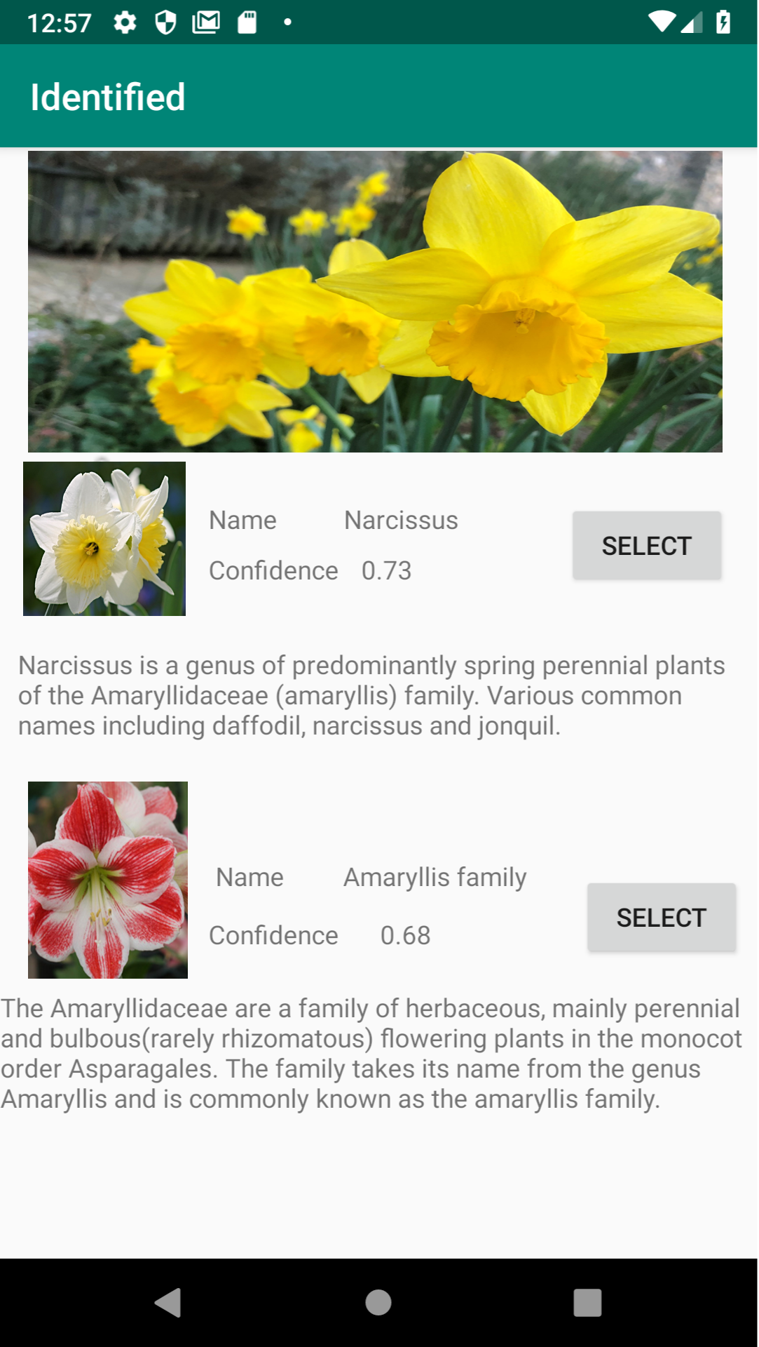
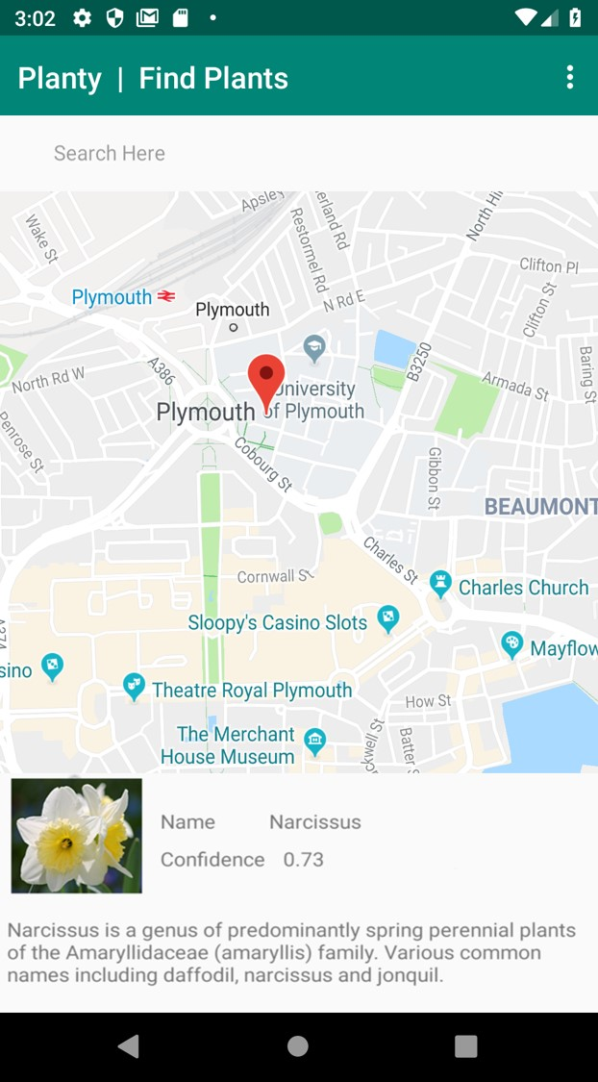





Planty: Plant Identifier and Finder
Introduction
Planty is a plant identification application, aimed at helping people to identify unknown plants and show users local businesses which sell that type of plant.
Identification
Users are able to take a photo of a plant, Planty then automatically provides a list of possible identifications using Google Cloud Vision, which the user can then select from.
Purchase location
Once the plant has been confirmed as a correct identification, the user is then shown the local businesses which sell that plant.
Search
To help users find locations to purchase particular plants, a search feature allows the user to enter keywords or business names, to find local businesses which sell a particular plant.
History
To keep track of all the identifications, Planty provides a list of plants which the user has successfully identified, allowing the user to view their previous identifications.
Maxim Wenger
Bsc (Hons) Computer Science
max@maximwenger.com

Slide 2
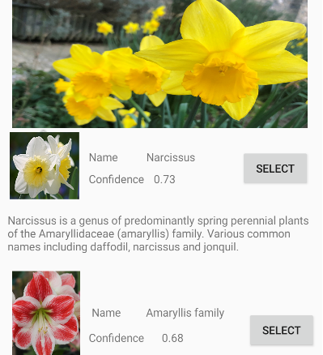
Showcase/Brochure Data
Please submit your completed .ppt file (no pdfs) on the DLE by April 4th 2019 at 4pm
Please supply a short TITLE for your project
Plant Identifier and Finder
Please supply a short DESCRIPTION of your project
Planty is a plant identification application, aimed at helping people to identify unknown plants and show users local businesses which sell that type of plant.
Users are able to take a photo of a plant, Planty then automatically provides a list of possible identifications using Google Cloud Vision, which the user can then select from.
Once the plant has been confirmed as a correct identification, the user is then shown the local businesses which sell that plant.
To help users find locations to purchase particular plants, a search feature allows the user to enter keywords or business names, to find local businesses which sell a particular plant
To keep track of all the identifications, Planty provides a list of plants which the user has successfully identified, allowing the user to view their previous identifications.
TECHNOLOGIES
Android
Firebase
Google Cloud Vision
Google Maps
Kotlin
Your
Image
here
…
4. Please indicate (highlight your choice) which STYLE of showcase
you will use
Hard copy poster + Demo on personal laptop
Hard copy poster only
Other, please specify
_________________________________
5. Finally, please (this will help me a lot!!!) save your file as follows:
YourDegree + YourName + StyleABorC
Examples
Computing JohnSmith StyleA
ComputerScience GeorgeJones StyleB
CGD LizStuart StyleC
CIS AlmaRahat StyleA

